Slide 1
Social Media
Pinterest Marketing

Slide 2
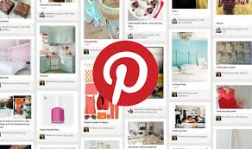
Pinterest Marketing
Pinterest is a dynamic social media platform for sharing favorite images, videos, fun media, etc. It can be termed as a visual bookmarking tool.
Using Pinterest, you can connect with other like-minded people by sharing your hobbies and interests through online bulletin boards.
Pinterest taps into a very fundamental human behavior – the desire to collect things (even if they may not be of any apparent value).

Slide 3
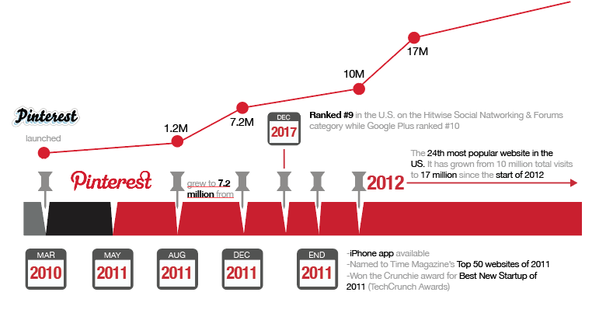
History of Pinterest
Ben Silbermann is an American Internet entrepreneur who co-founded Pinterest. He is also the CEO of Pinterest.
Silbermann says that the genesis of Pinterest really came from his love of collecting as a kid. “Collecting tells a lot about who you are,” he said, and when they looked at the web, “there wasn’t a place to share that side of who you were.”

Slide 4
Pinterest – Interesting Facts
Pinterest is now the fourth largest driver of website traffic.
Globally, the site is most popular with women.
In terms of age distribution, the Pinterest demography closely resembles the U.S. Internet population.
According to Hitwise data, by December 2011, the site had become one of the top 10 largest social network services, with 11 million total visits per week, driving more referral traffic to retailers than LinkedIn, YouTube, and Google+.
The average purchase generated by Pinterest is double the amount of those started on Facebook or Twitter.
80% of pins are repins as opposed to about 5% Tweets that are ReTweets.

Slide 5
How it Works
Pinterest is a free website that requires a valid registration. You can create either a free personal account or a business account as per your requirement.
Users can upload, save, sort, and manage images known as pins and other media content (e.g., videos and images) through collections known as pinboards. Pinterest acts as a personalized media platform.
Users can browse the content of others in their feed. Users can then save individual pins to one of their own boards using the "Pin-It" button, with Pinboards typically organized by a central topic or theme.

Slide 6
Content can also be found outside of Pinterest and similarly uploaded to a board via the "Pin-It" button, which can be downloaded to the bookmark bar on a web browser, or be implemented by a webmaster directly on the website.
They also have the option of sending a pin to other Pinterest users and email accounts through the "Send" button.
When you login to your Pinterest account, you will be seeing your home feed. Your home feed shows you all of the most recent pins from the other Pinterest accounts you follow.

Slide 7
Pinterest Slang

Slide 8
What are Pins?
Pins
Pins are ideas people find and save from around the web. Each Pin links back to the website it was saved from. If you click through the Pin you can learn more about it—like how to make it or where to buy it.
The Save button
The Save button does exactly that—it saves your ideas and Pins! As you discover Pins you’re interested in, save them to your boards by clicking on the red Save button.

Slide 9
What are Pins?
Bring your ideas to Life
When you see a Pin that you’ve always wanted to try, do it! And share how it went by adding a photo or note.
Send Pins to other People
It’s easy to share ideas with other people. By sending Pins to your friends, you can turn a camping trip into a camping party!

Slide 10
Boards
Boards
Save Pins to boards to easily organize your ideas. The Pins you save live in the boards you create. Name your boards whatever you want and arrange them in any order you like. Oh! Did we mention that you can add other people to your boards? Friends who save Pins together, stay together!
Board Sections
Sections are boards within boards and they make your ideas even easier to find and organize. If you have a furniture board imagine creating sections that organize your ideas to different color, size, or occasion—there are no rules, so get inspired to create!

Slide 11
Following and you Home Feed
Home Feed
Your home feed shows the Pins saved by the people, topics and boards you choose to follow. We also sometimes show you Pins inspired by your boards or recent activity to help you find ideas you might like. Your home feed is your space. Build it as you like by following anyone who’s saving ideas you love or would like to try. More on following below!

Slide 12
Following and you Home Feed
Following
Follow topics, people and boards you’re passionate about to personalize your home feed. When you follow something, their Pins make up the majority of your home feed so be sure to follow what you love or people who inspire you.

Slide 13
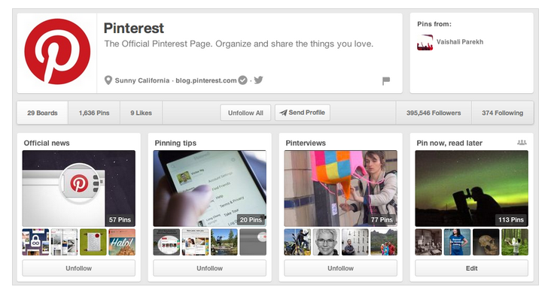
Your Profile
From the boards you create to everything you’re following, your profile is who you are and the ideas you love.
In your profile, you can find all the Pins you save, boards you create and Pins you try. You can also find who’s following you and everyone you’re following, including boards and topics.
Anyone can see your profile, but your secret boards will stay hidden. When you create an account we’ll make a username for you, but personalize your profile by updating your username, adding a photo and creating a bio.

Slide 14
Pinterest as a Marketing Tool
interest can be used as a social networking tool to promote your business. It is meant to be a little informal compared to other available forms of marketing.
Pinterest allows businesses to create pages aimed at promoting their companies online. Such pages can serve as a virtual storefront.
For example, in one case study of a fashion website, users visiting from Pinterest spent $180 compared to $85 spent from users coming from Facebook. These users spent less time on the company's website, choosing instead to browse from the company's pinboard.

Slide 15
Pinterest as a Marketing Tool
Further, brand studies have continued to show Pinterest is more effective at driving sales than other forms of social media.
In 2013, Pinterest introduced a new tool called Rich Pins to enhance the customer experience when browsing through pins made by companies.
Business pages can include various data, topics and information such as prices of products, ratings of movies or ingredients for recipes.

Slide 16
Pinterest as a Perfect Media Strategy
You can start a business page with Pinterest as a part of your media strategy initiative to generate new opportunities to connect with your customers and other communities with shared interests. It has the potential to generate substantial revenue and attract heavy traffic in the long run.

Slide 17
Promoting Business through Pinterest
Strategies for Digital marketing
Building boards that get noticed, drive traffic, and convert fans into customers
Creating your Pinterest community through high-engagement activities, contests, social media outreach, and smart pinning strategies
Ease of Marketing
Creating a marketing campaign becomes easy and attractive.
Selling the content to a target audience is crucial and Pinterest is good at that.

Slide 18
Setting up your Business Account
Whether you are an established brand, a non-profit organization, or a blogger, you can join Pinterest for free as a business. You can make a new business account or convert your current one.
If you have a personal account, log out of it.
Go to Pinterest for Business and click Join as a Business.
Fill out the details about your business and the person who'll manage the account.
Read and accept the Business Terms of Service and click Create Account.

Slide 19
Pinterest vs. Other Social Platforms
Pinterest is based on photos. People love to know what they're looking at. It's easier to shop, love, like, hate, in short, make an opinion on, something that you can see.
The design of the site is visually appealing. It is engaging in a way that other social platforms haven't been.
Pinterest has a clean user interface, uncluttered by ads or noise. The user interface is easy, manageable, and clean.
Pinterest can be used as an effective tool for interaction with prospective customers.

